Slide 1



VOD2Video
AI-Powered Long-Form YouTube Video Generation from Livestream VODs
Group 5: Kurt Jensen, Ian Wood, Drew Peterson

Slide 2



Background
Livestreaming has various ways to monetize continuous hours of content quickly
Livestreaming also provides the ability to interact with the chat and build a community in a more fluid way
Through Q2 of 2025 over 8 billion hours of livestreaming content was consumed between Twitch, YouTube Gaming and Kick

Slide 3
The Problem
However, promoting one's stream can be challenging
Since posting livestreams after the fact can be found less entertaining, this introduces clips
Clips or highlights allow for creators to promote the best parts of their content and skip moments with dead space
However, it can take hours of scrubbing to find even 10 minutes of clips

Slide 4
Our Solution
Use a deep learning model to take long form VOD (video on demand) to a cleaned and condensed YouTube video
The project is intended to solve a real content-creation problem: manually reviewing long streams to create engaging YouTube videos is time-consuming and repetitive.
From a machine learning perspective, the main objective is to build a deep learning model that predicts whether a video segment is highlight-worthy or not.

Slide 5
Supplemental Research
Yao, Mei, and Rui, "Highlight Detection With Pairwise Deep Ranking for First-Person Video Summarization," CVPR 2016.
Mahasseni, Lam, and Todorovic, "Unsupervised Video Summarization with Adversarial LSTM Networks," CVPR 2017.
Wei et al., "Learning Pixel-Level Distinctions for Video Highlight Detection," CVPR 2022.
Introduced ranking pairs of video segments against each other to determine which is more highlight worthy
Demonstrated that LSTMs can effectively model temporal structure in video for summarization tasks.
Showed that the quality of visual feature extraction is critical for highlight detection performance
Validates our ranking pipeline
Shows the LSTM architecture
Guides our ResNet backbone

Slide 6

Why LSTM
Highlights are more than just a singular frame: The LSTM processes the 8 frame embeddings in order and learns which patterns of change correlate with highlights.
The gating mechanism selectively remembers and forgets: The forget gate ($f_{t}=σ\left(W_{f}\left[h_{t−1} , x_{t}\right]+b_{f}\right)$ lets the model discard stale information (Loading Screens, breaks, etc).
Cell state preserves signal across the full sequence: The LSTM's additive cell state update avoids gradient decay, which matters because the difference between frame 1 and frame 8 is often the strongest highlight signal.
Final hidden state compresses the entire clip into single decision vector: That single vector feeds directly into the classifier, giving it a richer representation than any individual frame or static average could provide.

Slide 7
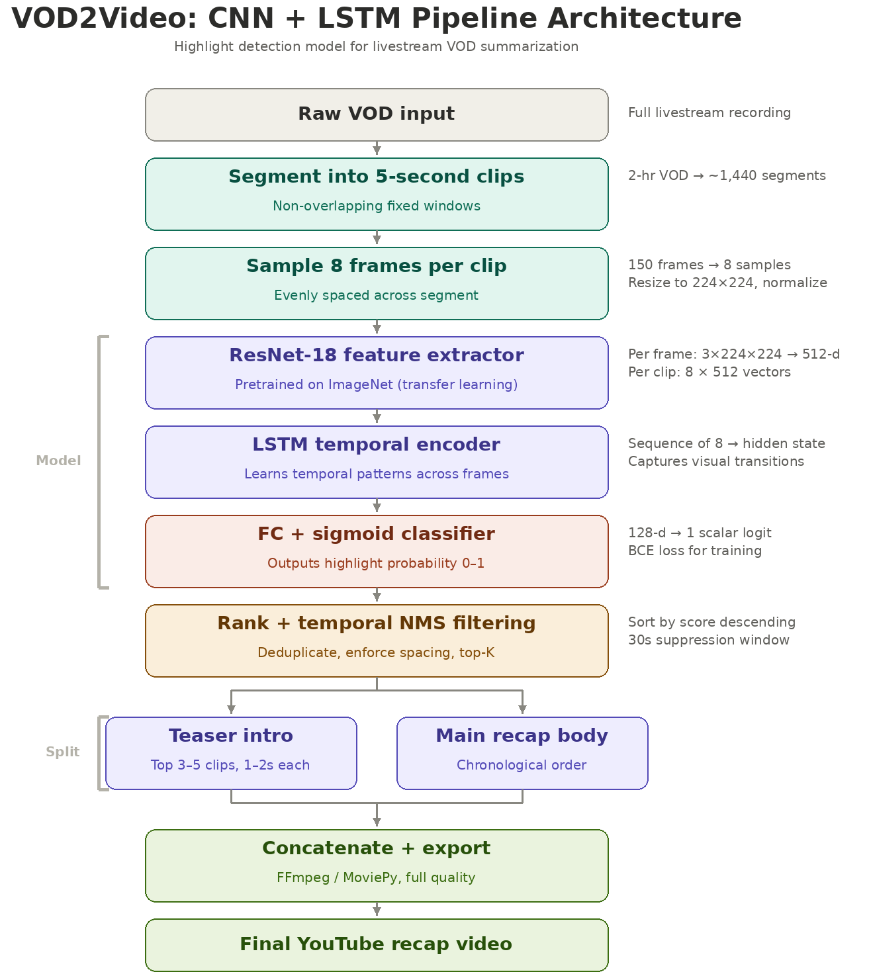
Our Proposed Model
The original base model for this project was a CNN + LSTM architecture with transfer learning.
But we switched it to a CNN + LSTM architecture with an added a MLP classifier
The CNN extracts visual features from frames, the LSTM model temporal behavior across each clip, and the MLP helps improve the final highlight / non-highlight decision.
We added the MLP because the program is still having trouble consistently classifying what is actually a highlight.
This gives us a stronger decision layer while keeping the temporal benefits of the CNN + LSTM pipeline.
Finally, our output layer will give each clip a binary label or score as to whether it should be used in the final compilation

Slide 8
Dataset
Custom dataset made up of 5 second clips from two of the most popular YouTube streamers
Initial test needed to be kept smaller to get results ending up with a ratio of 157 : 843 highlights to non-highlights
Training/Validation/Testing split is 70/15/15

Slide 9
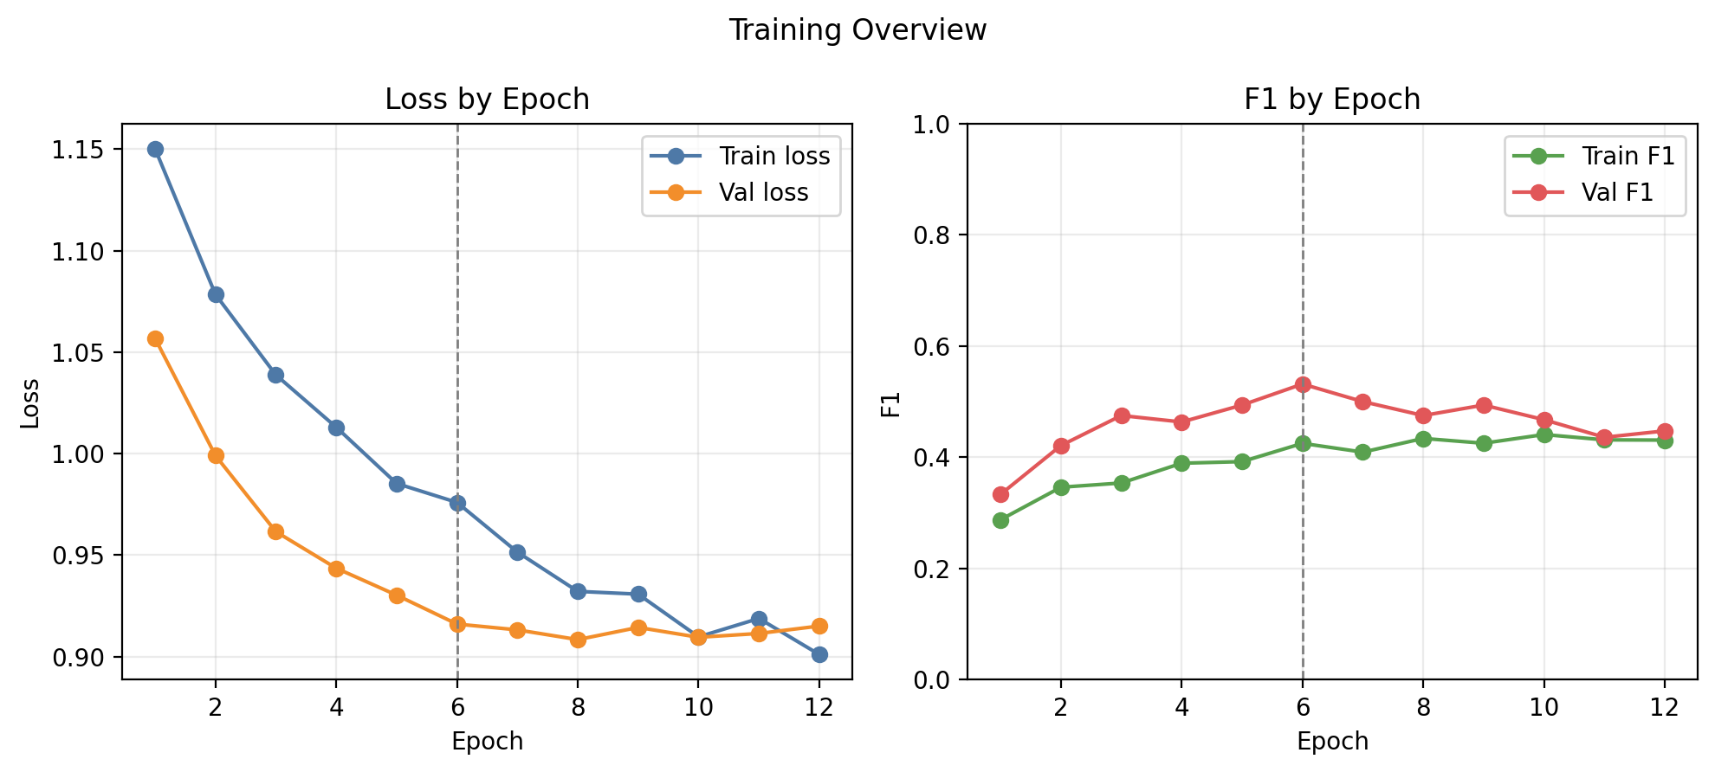
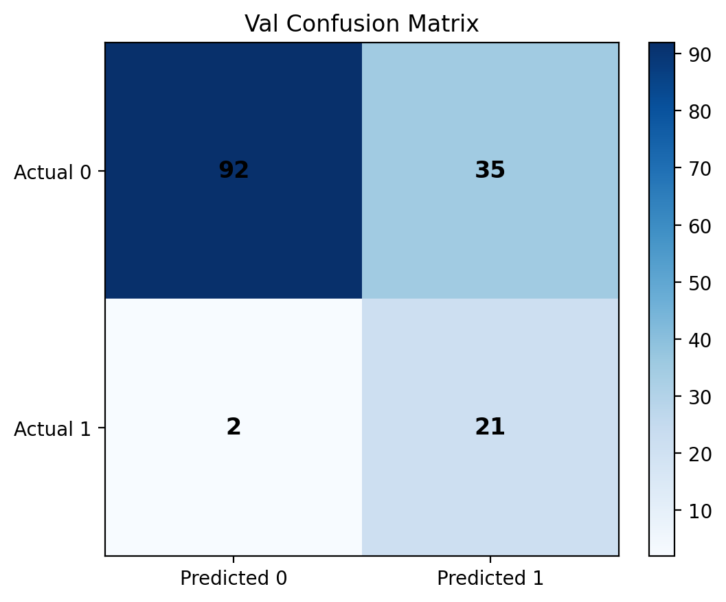
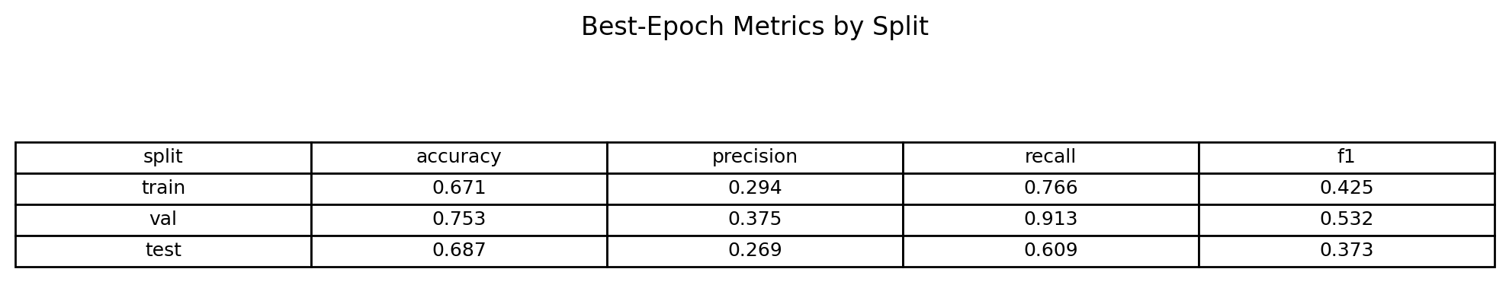
Current Progress/Results
Model converged smoothly over 12 epochs with best validation F1 of 0.532 at epoch 6
The model has done a good job not missing highlights but is a bit trigger happy
However, missing a highlight entirely is more harmful than including a boring clip

Slide 10
Planned Potential Experiments
CNN only vs CNN + LSTM: Does sequence information improve highlight detection?
Transfer learning vs Reduced train from scratch: Is a pretrained ResNet backbone better?
Adam vs SGD with momentum: Which optimizer works better and how do they effect performance?
Model exploration: I also experimented with different approaches, including a conventional autoencoder with a ResNet18 swap
Autoencoder result: That setup did not preform well and ended up being close to a coin flip for classifying highlight vs non-highlight clips.
Regularization Experiments: How do you reduce overfitting of smaller dataset?
Varied Clip Length: Compare different segment windows 3s/5s/10s, which captures highlights the best?
Highlight Assembly Logic: Once gathered what's the best way to structure the scored clips?

Slide 11
Limitations and Future Plans
Dataset is relatively small compared to total number of streamers across all platforms.
Data also has a lack of game variety, which may influence certain features.
Current state is only 5 second clips when highlights can be of various lengths.

Slide 12
Questions?

